Slide 1



Continuous Integration
Streamlining Software Development
Presenter
Mohammad Anees Alam
Notes:
1

Slide 2








Leveling Up in DevOps: Progress & Next Steps
Automation scripts
Testing
Ansible
Terraform
Continuous Integration (CI)
Continuous Deployment (CD)
Docker & Kubernetes
AWS Cloud
Notes:
2

Slide 3





Topics for today!
Understanding Continuous Integration (CI)
Introduction to CI Tools
Real-life use-cases of CI
Exposure to Basic CI Pipeline & best practices
Bird's view of CI in DevOps cycle
Notes:
3

Slide 4

What is continuous integration ?
Notes:
4

Slide 5




What is Continuous Integration (CI)?
Continuous Integration (CI) is a DevOps practice where developers frequently merge their code changes into a shared main branch.
Each integration automatically triggers:
Builds
Automated Tests
Code Quality
If any issue occurs (like a failed build or test), the team is notified immediately.
Notes:
5

Slide 6






Key Benefits of CI
Early Bug Detection
Faster Feedback Loops
Improved Collaboration & Code Quality
Reduced Integration Risk
Consistent & Repeatable builds
Better productivity & Faster releases
Notes:
6

Slide 7




CI in Action: Real-World Use Cases
Facebook
Google
Netflix
Amazon
Uses CI to test code changes instantly, allowing seamless feature rollouts across their massive platform while maintaining stability for billions of users.
Runs thousands of automated tests per day to ensure stability across their diverse product ecosystem, enabling rapid innovation without compromising quality.
Implements CI/CD to deliver updates without downtime, ensuring uninterrupted streaming service for millions of subscribers worldwide.
Uses CI/CD pipelines to enable continuous software updates for AWS services with minimal downtime, supporting global cloud infrastructure.
Notes:
7

Slide 8
Introduction to Continuous Integration (CI) Tools
"CI tools form the automation backbone of a CI/CD pipeline."
They automate important stages of development by:
  Fetching code from repositories (e.g., GitHub).
  Building and testing applications automatically.
  Giving instant feedback on code issues.
Why CI Tools Are Crucial in DevOps?
  Without CI tools, teams must manually build, test, and integrate code — increasing errors and delays.
Notes:
8

Slide 9

Popular CI Tools and Their Features
Travis CI
CircleCI
Jenkins
Cloud-based solution that integrates well with GitHub repositories. Travis CI is free for open-source projects and uses simple YAML configuration (.travis.yml) to define build processes.
Modern CI platform that supports Docker and Kubernetes for containerized workflows. CircleCI is optimized for speed with parallel job execution and offers flexible workflow configurations.
Open-source and highly customizable platform that supports various plugins for build automation. Jenkins can be deployed on-premise or in the cloud, making it versatile for different organizational needs.
Notes:
9

Slide 10

CI Tool Comparison
When selecting a CI tool, consider your project's specific needs, infrastructure requirements, and integration capabilities.
Each tool offers unique advantages that may align better with certain development workflows and organizational structures.
Feature
Jenkins
Travis CI
CircleCI
Open Source
✅
❌
❌
Cloud-Based
❌
✅
✅
Docker Support
✅
✅
✅
GitHub Integration
✅
✅
✅
Notes:
10

Slide 11




Setting Up a Basic CI Pipeline
Build
Test
Deploy
Compile the code and check for syntax errors. This initial stage ensures the code can be properly assembled into a working application before proceeding.
Run automated tests to ensure functionality. This critical stage verifies that the code performs as expected and doesn't break existing features.
Push changes to staging or production environments. This final stage (covered in CD topic) delivers the verified code to users.
Notes:
11

Slide 12
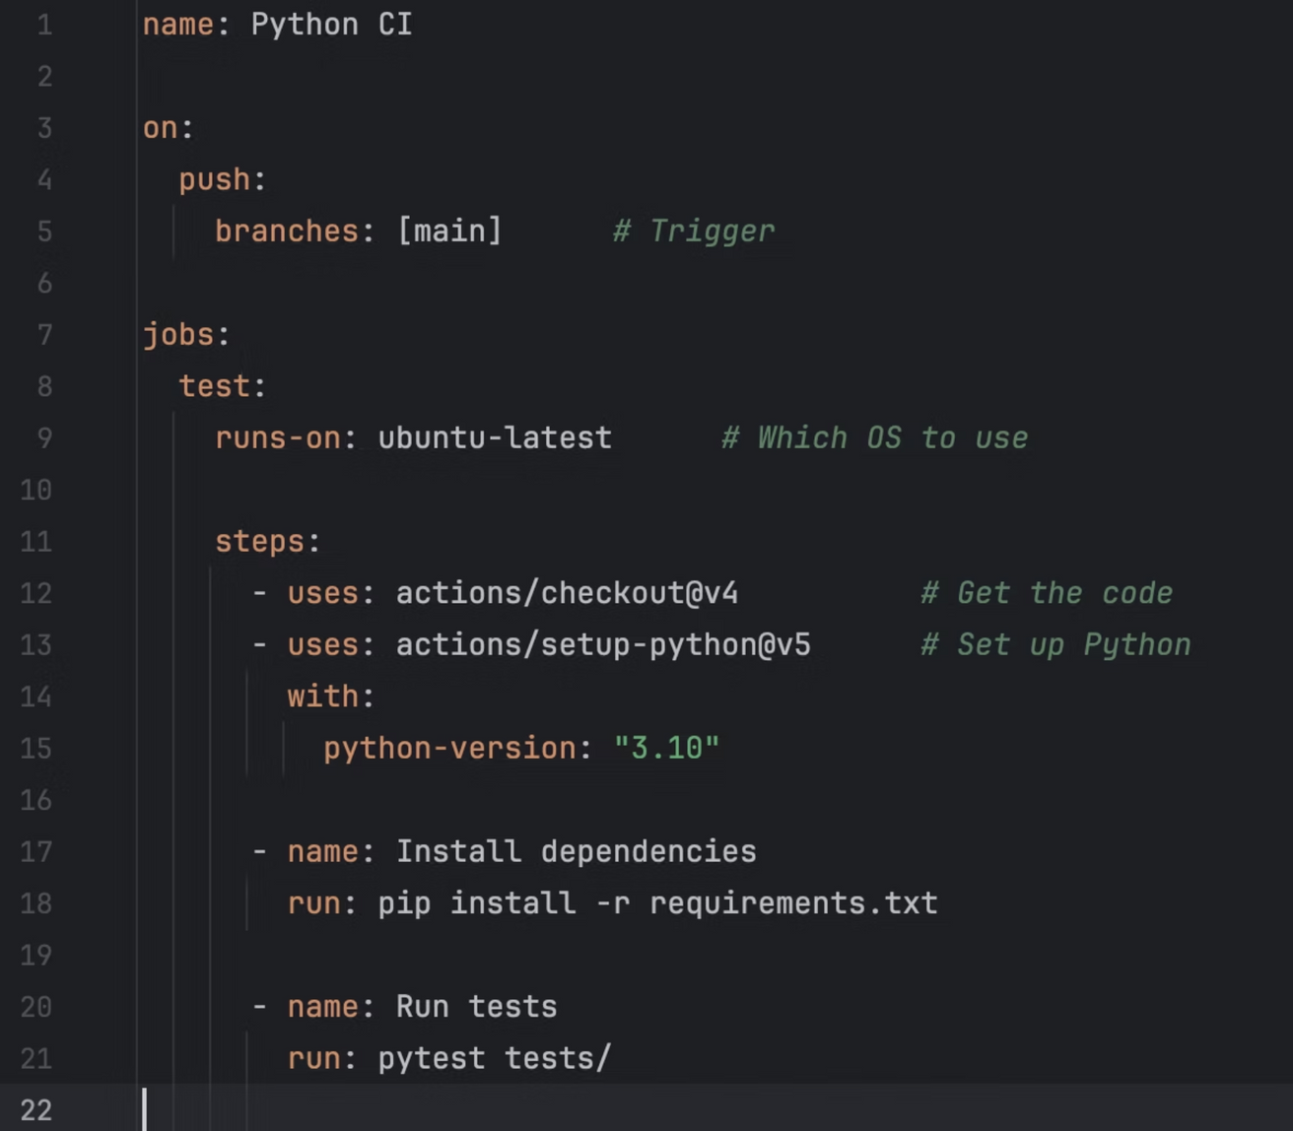
Basic CI Pipeline from GitHub Actions:
Notes:
14

Slide 13
Common CI Pitfalls & Best Practices
Common Pitfalls
Best Practices
  Skipping tests in CI pipelines, which can introduce critical bugs in production
  Keep pipelines fast and efficient to avoid unnecessary delays
  Lack of proper error logging, making debugging CI failures difficult
  Use meaningful commit messages to help with tracking and debugging issues
  Overcomplicated pipelines with unnecessary steps that slow down development
  Ensure parallel execution where possible to speed up test completion
  Ignoring security checks, potentially allowing vulnerabilities to be deployed
  Monitor and analyze CI metrics to track failures and optimize processes
Notes:
15

Slide 14




Troubleshooting Common CI Issues
Dependency Issues
Failing Tests
1
Ensure all dependencies are correctly listed in requirements files
Check error logs to identify issues in test scripts
2
Environment Variables
4
Pipeline Not Triggering
Confirm all necessary environment variables are configured
3
Verify GitHub webhook integration is properly enabled
Notes:
16

Slide 15
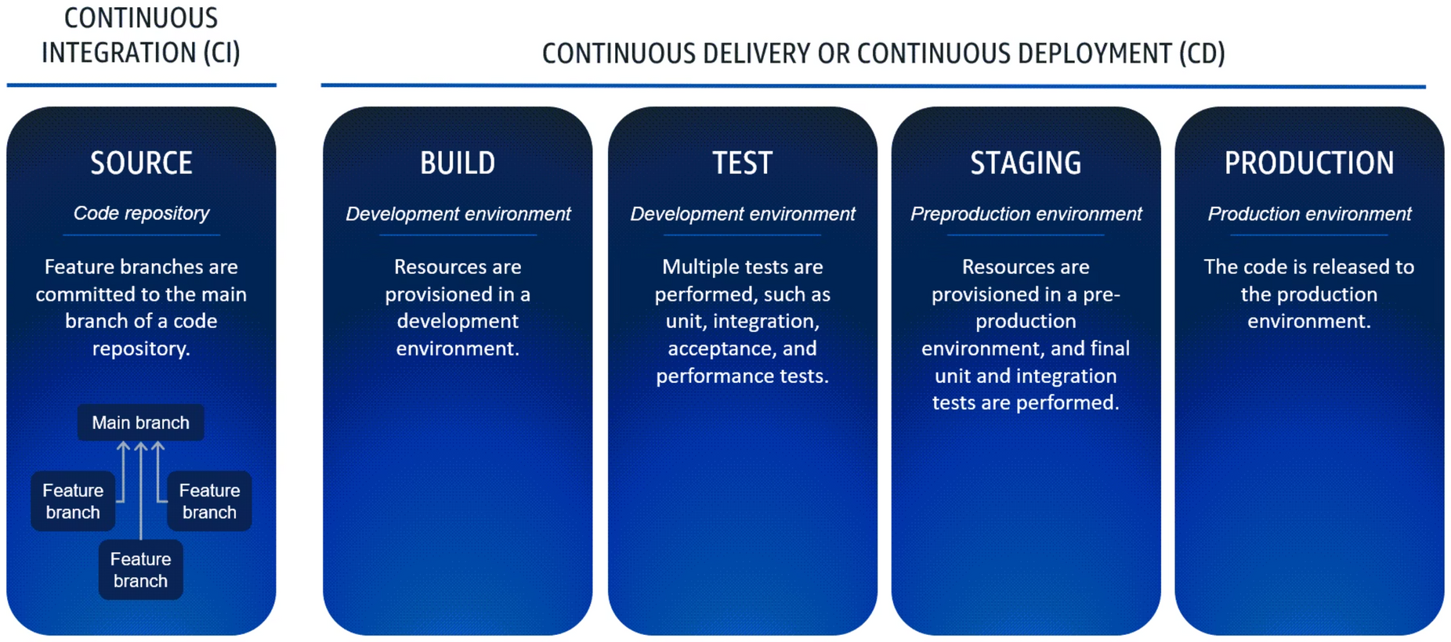
CI/CD Pipeline environments
  Continuous Delivery: Ensures code is always in a deployable state. Deployments require manual approval.
  Continuous Deployment: Fully automates the release process, deploying every validated change to production without manual intervention.
Notes:
12

Slide 16
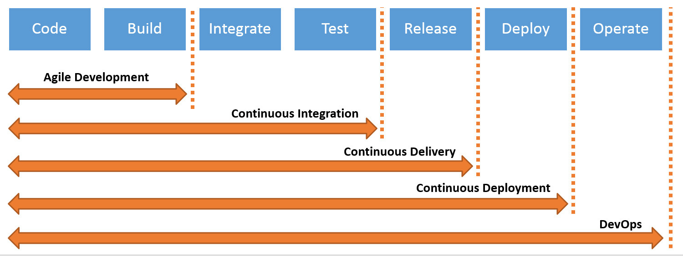
CI/CD Pipeline Stages
Notes:
13

